Slide 1
T/O, D/O, Base, Swing
Virginia Tallent for Judge

Slide 2
Turnout Percentage
-Out of 597,886 Eligible voters, there were 421,997 individual votes in this election
-Resulting in a T/O% of 74.77% of potential voters turning out for this election. A higher number given that it was a presidential election, like 2024
(According to https://votehamiltoncountyohio.gov/ Nov 6, 2012)

Slide 3
Drop Off Percentage
- Average total votes based on previous Presidential years
2012-289,562
Total number of votes, 421 997. Calculate with formula.
421,997-289,562/421997= 31.3% Drop Off
(According to https://votehamiltoncountyohio.gov/ Nov 6, 2012)

Slide 4
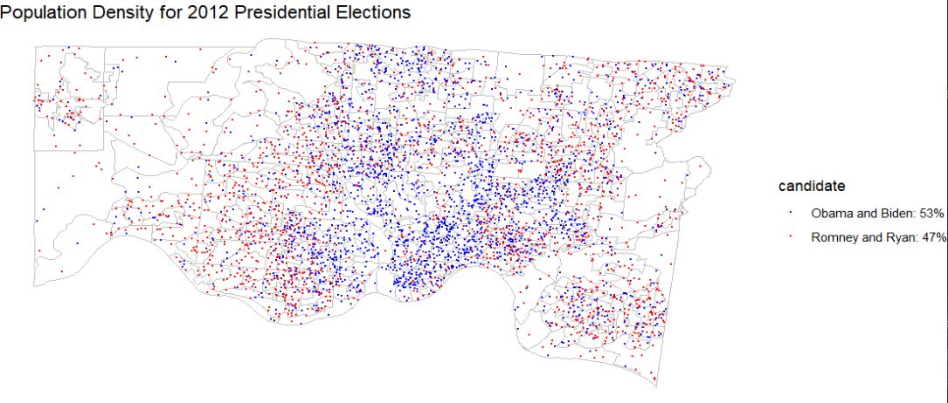
More clusters of dots shows higher concentration
Difference of political engagement

Slide 5
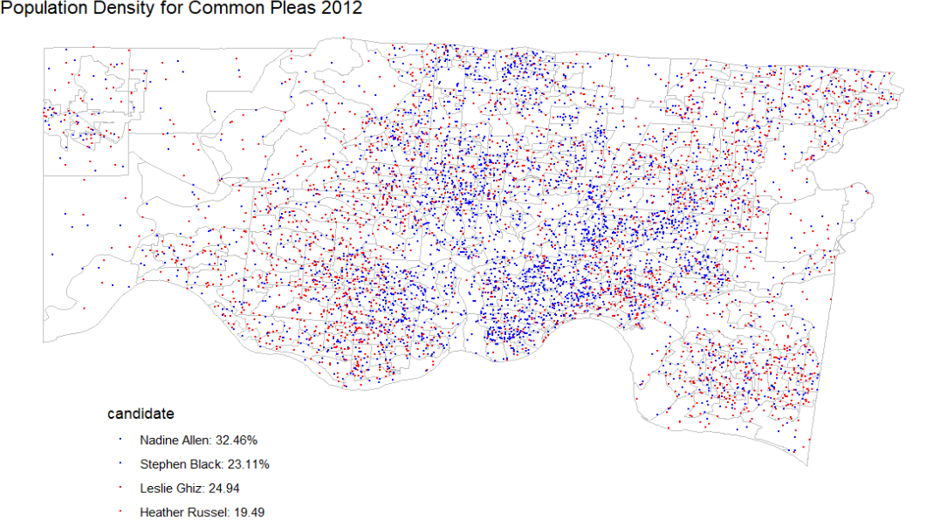
Differences between rural and urban patterns
Strategy for Virginia Tallents

Slide 6
Magic Number
Basing off the 2012 election and projecting upon the 2024 election
-599,902 x 0.7477 = 448,859 expected ballots
How magic number was calculated
-1,000 simulation of 1,000 ballots (later multiplied by 448.859)
-Ballot outcomes: (31.3% drop off, 4.44% vote one candidate, 64.26% vote two candidates)
-Magic Number: 119,823 votes (26.695%)
Notes:
]\

Slide 7
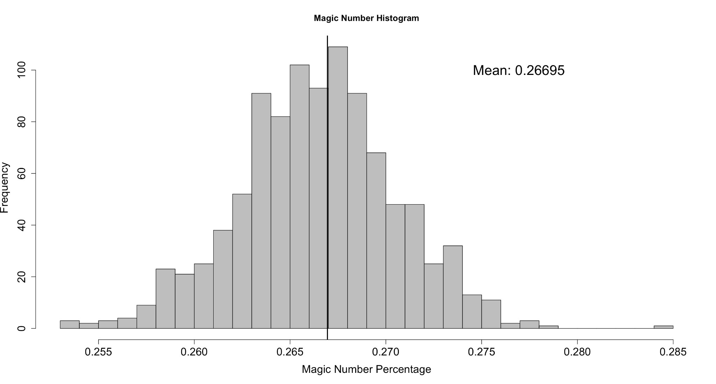
Magic Number Histogram

Slide 8
Methodology for Base Maps
Which election results were used?
All Base maps were based off of the 2022 election and cross referenced with 2020, 2018, and 2012 election results to ensure validity.
All Base Maps were constructed by Categorizing each of the candidates for the Court of common pleas for each year by their party affiliation at for that year of the election.
Then the proportion of votes for the Democratic candidates and Republican candidates were used to calculate a percentage that aims to show how many voters voted for a Democratic candidate for each precinct.
These percentages were assigned a color based on a Gradient from 100% (Blue) to 0% (Red), Then put on a map that identifies each precinct in Hamilton County.

Slide 9
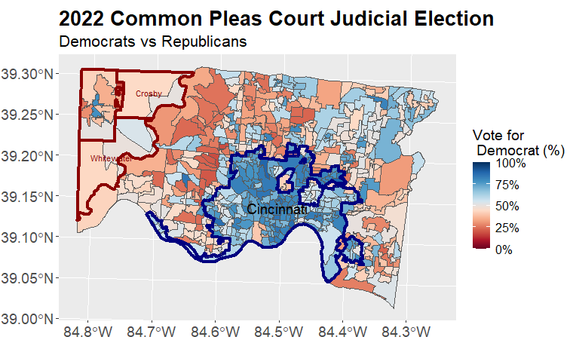
Base Map:
40% of Hamilton County votes Democratic for this election, 40% is swing and the other 20% is republican.
90% of the Democratic Votes come from the Cincinnati Area with the rest Scattered around the County

Slide 10
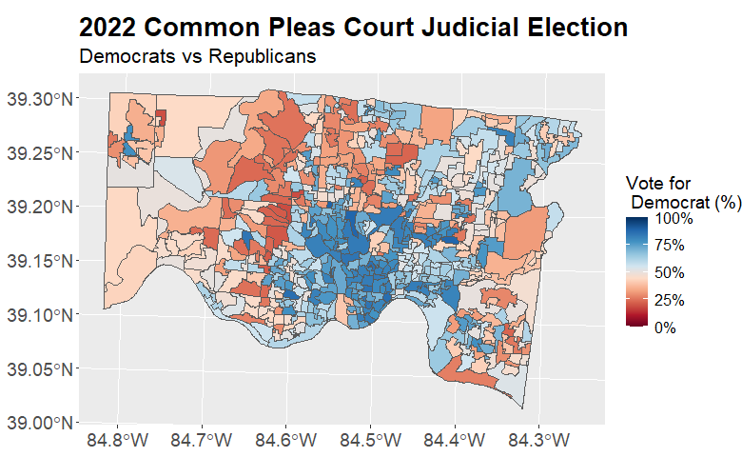
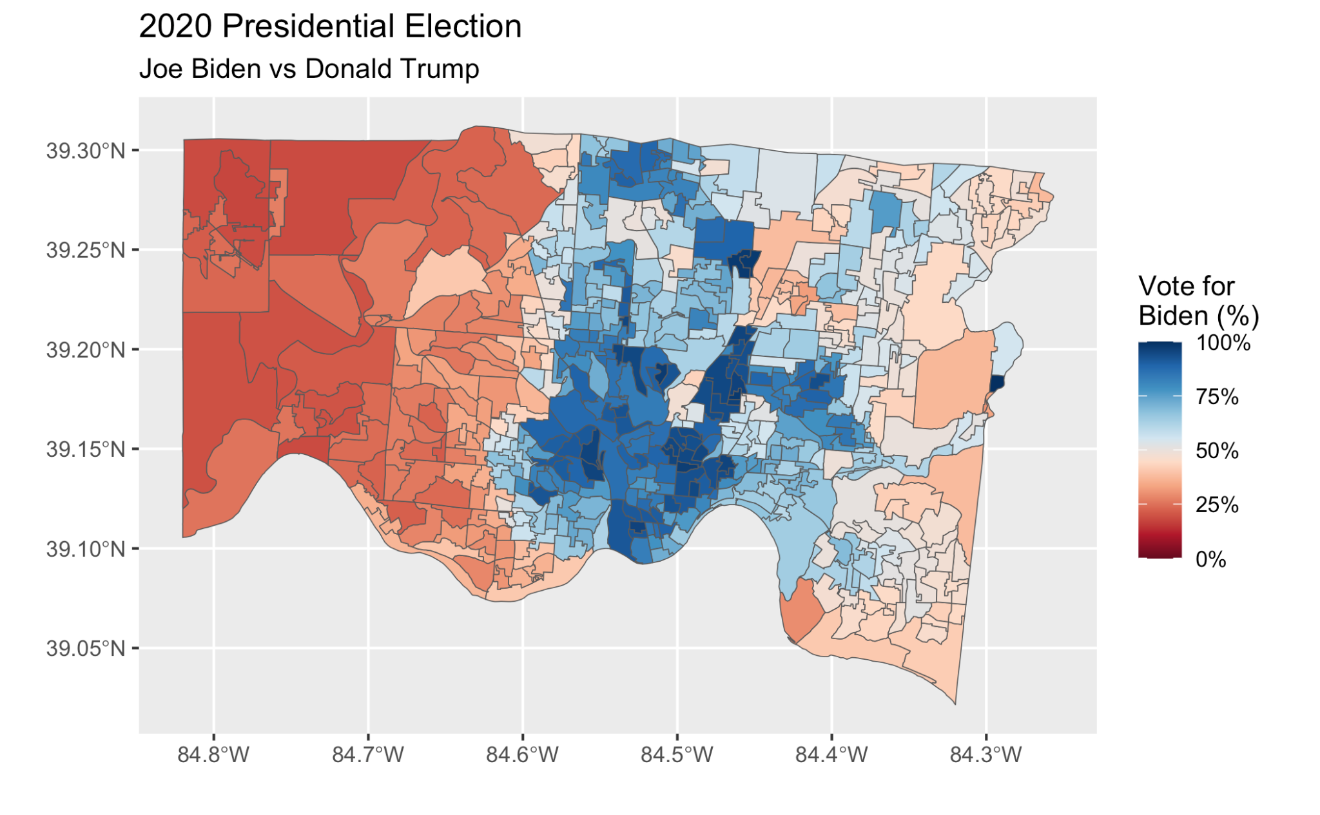
Base Map - Comparison
The difference in the coloring is the result of 4 out of the 7 Common Pleas Court Positions being filled by democrats in 2022, with 3 democrats winning by more than 50,000 votes.
Each Republican that won for this election won by around 10,000 votes with one winning by 20,000.
The Variation in Color can also be explained by the fact that Judges are not labeled on the ballot, therefore people do not always vote for their affiliated party.

Slide 11
Methodology for Base/Swing
-Based off of the Precinct election results?
-Which Precincts have reliably voted majorly Democrat in the last couple of elections?
-Same principle for swing, who is close enough to be considered potential voters?

Slide 12
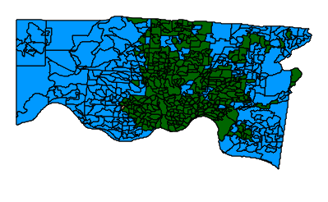
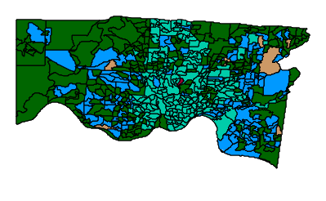

Swing
Who can be relied upon to vote for a specific candidate?
Court of Common Pleas results-2018
Race #3
Race #1
Race #2

